Slide 1
CS 481 Pattern Recognition
Submitted to:
Prof. Dr. Mostafa Gadal-haqq
T.A. Mohamed Rasmy
Team members:
omnia ashraf

Slide 2

Problem Statement (Definition)
The problem we are facing is that we have five algorithms (Bayesian Decission, K-NN, RANDOM FOREST , TREE or SVM) which we need to choose two of them to implement on one of three datasets (The Heart Disease Dataset , The Diabetes Dataset or The Hipatities Dataset),
So we need to know which algorithms are we going to use and which dataset we are going to implement on .

Slide 3
The Proposed solution
Choose two algorithms from the list
Preprocess the dataset as needed
Split the dataset into training and testing sets, typically using a 80/20 or 70/30 split.
Train the first algorithm on the training set and make predictions on the testing set.
Train the second algorithm on the training set and make predictions on the testing set.
Compare the performance of the two algorithms and choose the one that performs better on the dataset.
Fine-tune the chosen algorithm by adjusting its hyperparameters, if applicable, and retrain it on the training set.

Slide 4

System Tools
Software Requirements
Operating System :
Windows family
Technology : Python3.7
IDE : Kaggle jupyter notebook
Hardware Requirements
Processer : Any Update Processer
Ram : Min 4GB
Hard Disk : Min 100GB

Slide 5

Results and Discussions
The overall performance of the algorithms: both algorithms acted well
The strengths and weaknesses of the algorithms: they both handled the data properly
Any potential biases in the dataset or evaluation process: the dataset didn’t contain any imbalances in the distribution of classes that may have affected the performance of the algorithms

Slide 6

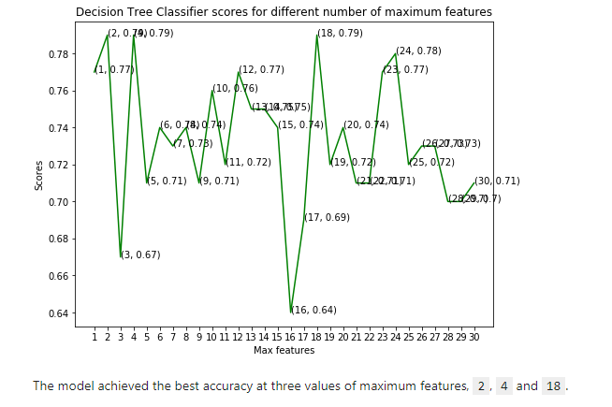

Slide 7

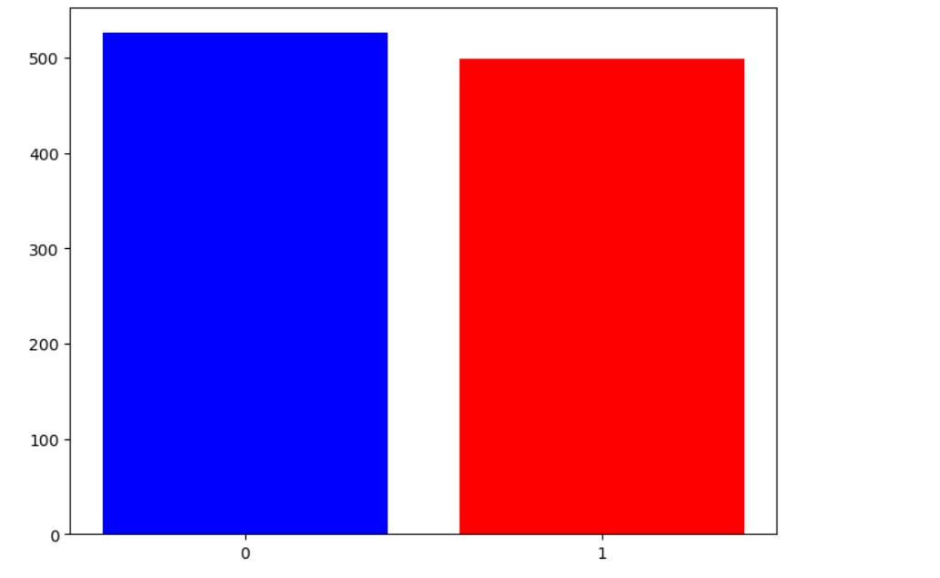
standscaler process

Slide 8
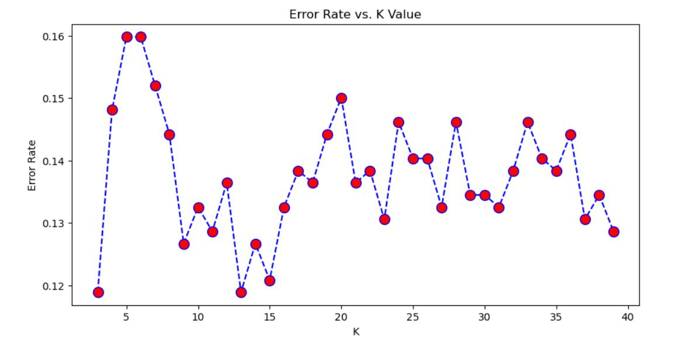
Error rate and value

Slide 9
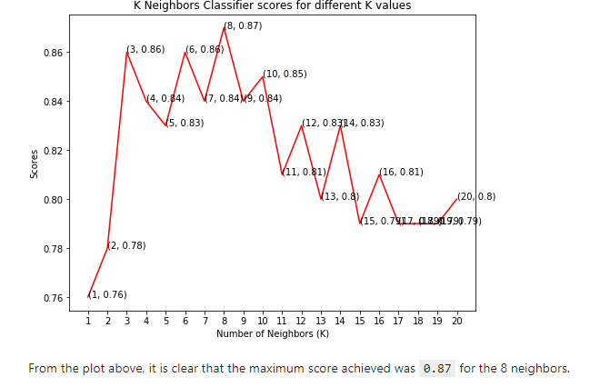
K neighbour classifier scores

Slide 10

Conclusions
In this project, we used Machine Learning to predict whether a person is suffering from a heart disease. After importing the data, I analysed it using plots. Then, I did generated dummy variables for categorical features and scaled other features. I then applied four Machine Learning algorithms, K Neighbors Classifier, Support Vector Classifier, Decision Tree Classifier and Random Forest Classifier. I varied parameters across each model to improve their scores. In the end, K Neighbors Classifier achieved the highest score of 87% with 8 nearest neighbors.

Slide 11

Thank you

